Slide 1
Auto electrical System
ME 6210
Number of Credits: 9

Slide 2
layout of auto-electrical system
charging system
starting system.
lighting system
auxiliary systems
Ignition system
Automotive Actuators
Automotive Sensors

Slide 3
components of auto-electric
Power sources
Loads
Resistors
Controls devices
Protective devices
Electronics devices

Slide 4
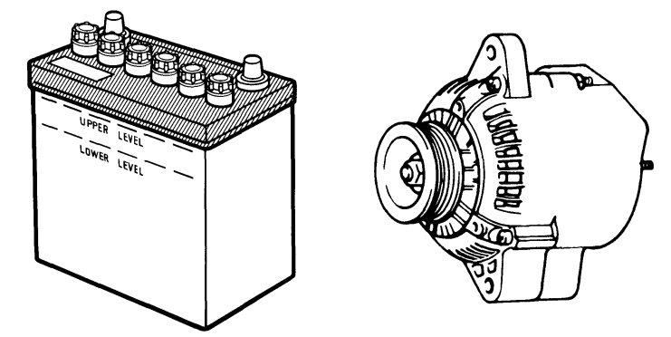
components of auto-electric
Power sources
power source are used on vehicles when the engine is not running or being started, battery provides power.
When the engine is running, the alternator provides power for the vehicle’s loads and for recharging the battery

Slide 5
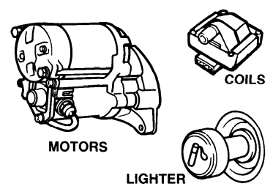
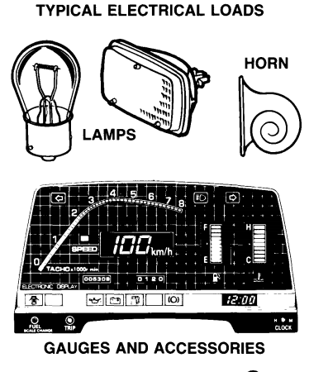
components of auto-electric………..
2. Loads
working devices or loads consume electricity. They change electrical energy into another form of energy to do work.
This energy may be thermal(heat), radiant(light), mechanical (motive), audio(sound), chemical, or magnetic. The electrical energy is changed by the resistance of the working devices.

Slide 6
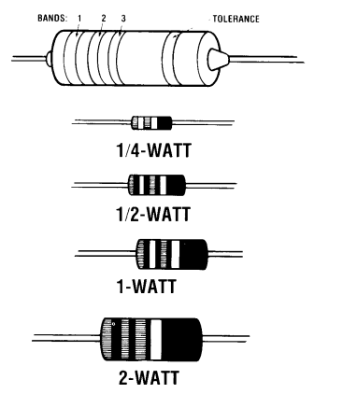
components of auto-electric……..
Resistors
fixed value, stepped or tapped, and variable

Slide 7
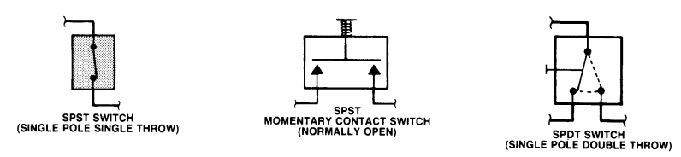
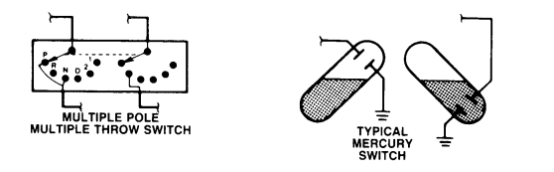
components of auto-electric…………
4. Controls devices
control devices used in electrical circuits on vehicles include a variety of switches, relays and solenoids.
electronic control devices include capacitors, diodes, and transistors. Controls are needed to start, stop, or redirect current flow.
Most switches require physical movement for operation, relays and solenoids are operated with electromagnetism, electronic controls are operated electrically

Slide 8
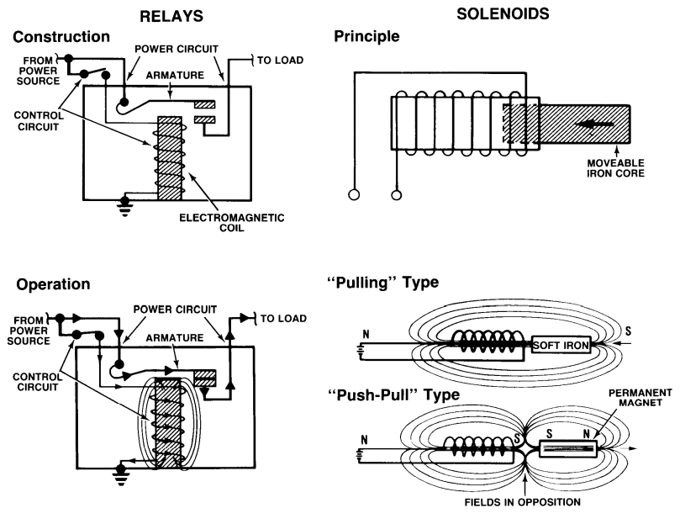
components of auto-electric…………

Slide 9
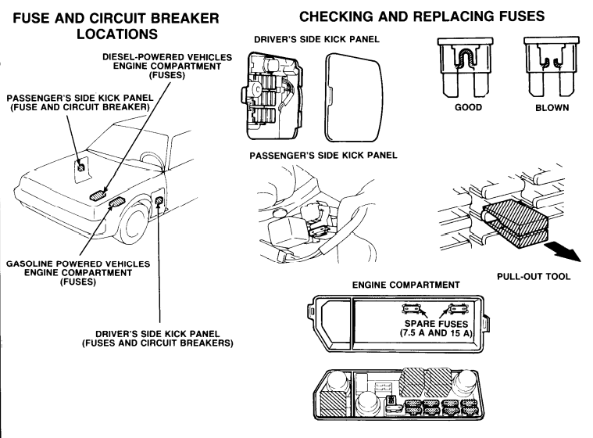
components of auto-electric…………
5. Protective devices
Electrical circuits are protected from too much current by fuse, fusible links and circuit breakers.
Such devices interrupt a circuit to prevent high current from melting conductors and damaging loads, these devices are sensitive to current

Slide 10
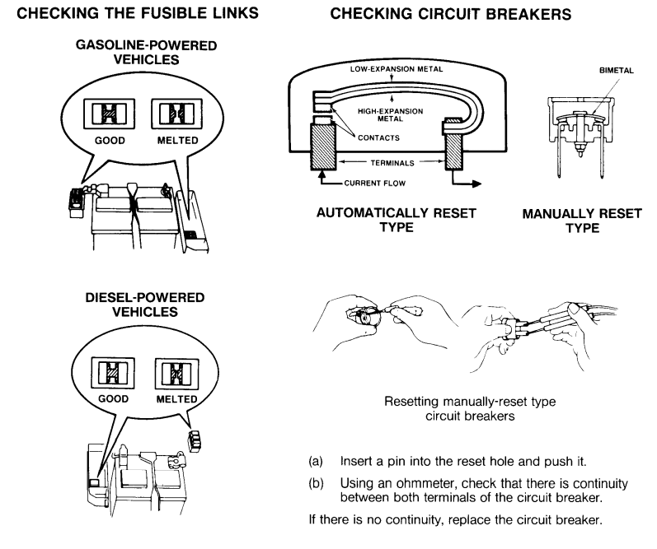
components of auto-electric…………

Slide 11
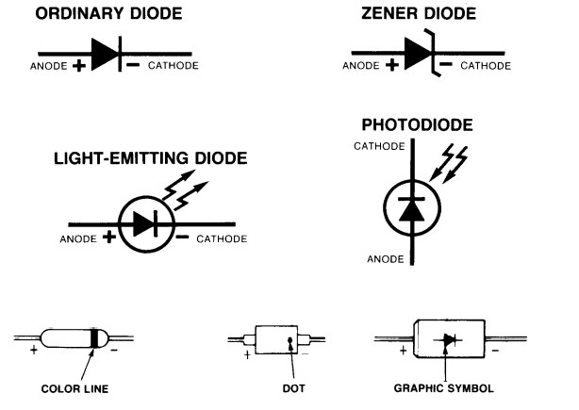
components of auto-electric…………

Slide 12
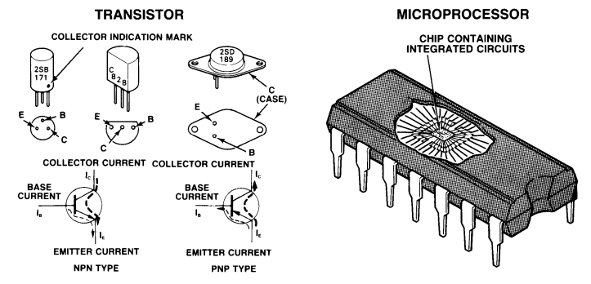
components of auto-electric…………

